Slide 1
Software Architecture
Anti-Patterns

Slide 2
What are Anti-patterns?
"An Anti-Pattern describes a commonly occurring solution to a problem that generates decidedly negative consequences."
Generally, it happens because an architect…
  Does not have sufficient knowledge or experience solving a particular problem
  Applied a perfectly good design pattern in the wrong context
    e.g. microservices in a small project unnecessary complexity
      Complexity doesn't disappear
  Adopted the right pattern but deviated over time, undermining its intended benefit
    e.g. layered architecture. where upper layers bypass lower → defeats separation of concerns

Slide 3

Jumble
Horizontal and vertical design elements are intermixed (ball of mud).
  E.g.
    Started with well-structured layers (UI, logic, data)
    Need a quick fix
    Break the layer pattern (e.g., UI requests a database directly)
    And again, and again, and again…
    Architecture erodes; the architect and other key members move on to the next project
  QA effects
    Modifiability – unpredictable ripple effects; hard to maintain or enhance
    Testability – tangled logic prevents component isolation
    Deployability – coupled components force all-or-nothing deployment

Slide 4
Jumble - Example
Initially
  Cart service – logic for a shopping cart
  Logging – via a centralized framework
  Auth – provided by a separate service
After "let's fix it quick"
  Logging directly to a file in Cart service
  Credentials are checked inline
  Update SQL-requests in a controller
Consequences
  Want to re-configure logging? Change all features
  Want to alter auth? Change all features
  Modifiability and Testability collapse as the system grows

Slide 5
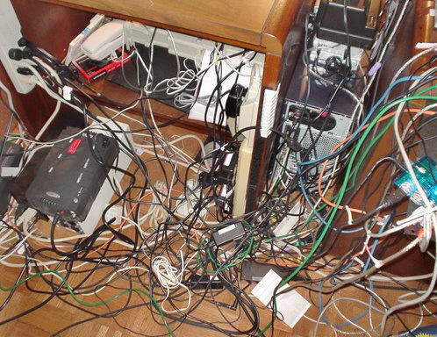
Stovepipe
What
  A lot of entities
  Integrated ad-hoc & point-to-point
  No reusable integration interfaces
Why
  Organic growth without a plan
  Short-term fixes
    Let’s integrate these 2 services & rework later
  Time pressure
  Each team picks their own stack of integration technologies
    SOAP vs gRPC vs JSONful vs RESTful vs RMI vs Kafka vs etc

Slide 6
Stovepipe
QA effects
  Modifiability – N*(N-1)/2 connections; one change can ripple across all of them
    10 systems = 45 connections; 20 systems = 190 connections
  Integrability – each team picks their own tech stack; no standard expertise required per integration
  Deployability – adding a new service forces modifications to all its point-to-point partners
Avoidance
  Planning
  Enforced standards
  ESB – ultimate solution (with trade-offs)

Slide 7

Cover Your Assets (CYA)
How it works
  Something goes wrong somebody is responsible
  Not us!
  An architect practicing CYA…
    Presents all options rather than committing to one
    Defers to developers – "you're trusted to decide"
    Let developers choose and take the blame responsibility
Consequences
  Bloated documentation with irrelevant options
  Devs don't have enough expertise
    Endless discussions
    Suboptimal solutions
  Lost trust – in requirements and architects
    What's the point to even ask an architect? → Architects lose understanding of the system

Slide 8
Cover Your Assets - Examples
In requirements
    System should use Oracle DB, SQL Server, PostgreSQL, or MongoDB
    Does it matter? If yes, which one?
In architecture decisions
    "I recommend to use Oracle DB, but as a principal engineer, you can make another decision"
    Trade-off framing shifts the decision – and the accountability – to the developer
Reasons
    Fear of accountability
    Politics – please all stakeholders by listing all alternatives
    Inexperience – not enough expertise to make a decision
    Risk-averse culture – avoiding mistakes is more important than delivering value

Slide 9
Vendor Lock-In
Let's save time & use a proprietary solution!
  Looks great at first
Issues
  Uncontrollable cost
    Can be changed at any moment
    Unity (2023): announced retroactive per-install fees – developers had no exit without rebuilding from scratch
  Technology stagnation
    Cannot adopt new technologies
    Fewer engineers willing to learn old tools
  Discontinued features
  New scope does not fit in
    Forces complex integration workarounds
  Regulatory compliance can force migration away

Slide 10
Vendor Lock-In
Why
  Time-to-market
    Legitimate pressure – but lock-in risk must be weighed
  Lack of architectural foresight
    Not understanding the problem domain
    Not anticipating long-term needs
  Over-trust in vendor stability
    "They will NEVER change the price or discontinue"
    Unity (2023): retroactive per-install fee after developers were already locked in
    AWS Lambda: proprietary event model and integrations – migrating to Azure or GCP means rebuilding
Avoid
  Use open technologies / standards
  Isolate vendor-locked components behind abstractions

Slide 11
Wolf Ticket
Essence
  Compliance with standards is claimed
    Not compliant in reality
Problem
  Clients believe they buy / commit to an open, portable solution
  Porting is costly due to differences
  Vendor lock-in in disguise
Examples
  SQL – standard
    Oracle, SQL Server, PostgreSQL, MySQL – each adds proprietary extensions
  Internet Explorer: claimed W3C compliance, implemented proprietary extensions (ActiveX, CSS quirks)
  Safari: WebKit-only behavior causes CSS/JS inconsistencies despite claiming web standards

Slide 12
Wolf Ticket
Why
  Marketing > ethics
  Intentionally lock in customers
  Weak standard enforcement
    "Our browser works differently, what are you going to do about it?..."
QA effects
  Integrability – products claiming the same standard can't interoperate
  Modifiability – vendor-specific flows inflate development cost
  Deployability – standard fragmentation makes migration and porting costly

Slide 13
Architecture by Implication
No architecture planning or documentation
  Architectural decisions made ad hoc
Why
  Overconfidence
    We don't need formal architecture; we'll figure it out
  Lack of awareness
    Ignorance of architecture practice
    Misconception: Agile means no architecture
    Time pressure – just ship it
  Often, both root causes reinforce each other

Slide 14
Architecture by Implication
Problems
  Inconsistent decisions
    Made by different engineers in different situations
  Driven by hidden assumptions
    Assumptions shift across engineers and over time
  Implementation risks
    Scalability, security, maintainability, extendibility, etc.
Example
  One team directly queries a DB from controllers with raw SQL
  Another builds a multi-layered architecture with ORM
  A third uses JSON files as storage
  Won't hold up at scale

Slide 15
Architecture by Implication
Avoidance
  Explicit architectural documentation
    Even lightweight diagrams are better than nothing
  Regular architectural reviews
    Validate decisions – new ones work with existing ones
  Agility / planning balance
    Full upfront architecture is not the best idea
    Should be enough to guide development

Slide 16
Design by Committee
Architecture influenced by too many people
  Over-complicated
  No single vision
Problem
  Complexity
    Multiple approaches mashed together
    Impossible to create an elegant solution
  Incoherence
    Patchwork architecture
    Nothing works well together -> instability points
  Inefficiency
    Long, unproductive debates
  Diluted responsibility
    No ownership

Slide 17
Design by Committee
Why
  Too many equal decision-makers – no single authority
  Lack of clear roles
    Unclear architect's authority – "just do what I say" without earned trust
  Consensus culture
    Avoid conflicts compromise architecture
  Political pressure
    I'm an investor and you must use this technology – because I invested in it
Avoidance
  Clear responsibilities
  Structured decision-making (e.g., RFC, Architecture Decision Records)
  Strong facilitation

Slide 18
Swiss Army Knife
“Universal interface / component”
  Instead of solving one problem well
  Tries to solve everything
Problem
  Overcomplicated
    Overloaded by parameters / modes / options
    → insane learning curve
    → high risk of misuse → bugs
  Confusing
    Too many ways to do the same thing
  Jack of all trades, master of none

Slide 19
Swiss Army Knife
Example
  A function with 15+ parameters – each is a blade on the knife
  uploadFile(String path, boolean async, boolean compress, String compressionType, boolean encrypt, String encryptionAlgorithm, boolean retry, int maxRetries, boolean validateSchema, String schemaVersion, boolean notify, String[] notificationEmails, boolean log, boolean debug)
  At architecture scale: one service handling file storage, auth, encryption, notifications, and logging
  Implementation nightmare: every parameter combination requires its own behavior path
Why
  Trying to predict every scenario upfront
  Design by committee – everyone insists "this feature is critical!" uncontrolled feature bloat
  Misunderstood flexibility – complexity adaptability

Slide 20
Swiss Army Knife
Avoidance
  YAGNI (You Aren’t Gonna Need It)
    Don’t build for imaginary needs
  Design for common use cases
    Add special cases if needed
    Evolve iteratively
  Separate concerns
    Decompose into focused sub-interfaces

Slide 21
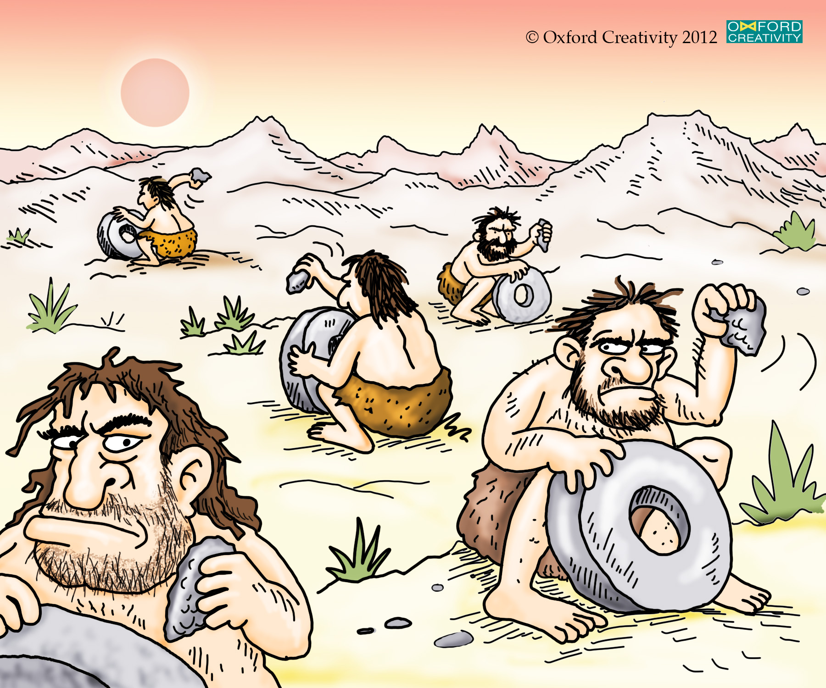
Reinvent the Wheel
Rebuilding from scratch something that already exists
QA effects
  Reliability – immature code has more bugs than proven solutions
  Modifiability – unique technical debt accumulates
Why
  Knowledge siloing – teams unaware of existing assets
  Overconfidence – "we can build better" (no, you cannot)
  Full control – valid sometimes; trade-off must be explicit
Avoid
  Evaluate existing libraries and frameworks before building
  Treat build-vs-buy as an explicit architectural decision
  Knowledge sharing to surface what already exists

Slide 22
The Grand Old Duke of York
The Grand Old Duke of York, he had ten thousand men, he marched them up to the top of the hill, and he marched them down again.
Essence
  Wasting efforts by not using people's talents efficiently
  In SE: treating engineers interchangeably (fungibility)
    Everyone is equal, so everyone can do all tasks equally
Problem
  Lost productivity
    Skilled architects fix UI bugs
    Strong coders write documentation
  Mediocre design
    Architecture shaped by engineers outside their expertise
  Frustration
    Experts are bored, newbies are overwhelmed

Slide 23
The Grand Old Duke of York
Why
  Egalitarian task allocation — treating skill sets as fungible
  Managerial inexperience
    Not recognizing individual skill sets
  Fear of elitism
    Perceived hierarchy: "real architects" vs. everyone else
  Rigid processes
    Following the rules instead of a practical approach
Avoidance
  Distinguish roles clearly
    Match by talents & interests (not always easy to notice)
  Encourage growth without forcing fit
    Let engineers learn architecture, but do not let newbies work on critical parts

Slide 24
References
AntiPatterns, Muller, University of Victoria http://www.csc.uvic.ca/~hausi/480/lectures/antipatterns.pdf
https://sourcemaking.com/antipatterns/software-architecture-antipatterns

